Slide 1


DATA ANALYSIS
of
-LAYOFFs-
Anan Gamal Mohammed Mohammed
Dalia Abbas Ahmed Mohammed Shaltout
Merhan Hassan Mohammed Elsawaby
Zainab Kamal Kamel Maamoun
1

Slide 2

what is Lay-Off?
A layoff is the temporary or permanent termination of a worker's employment for reasons unrelated to the individual's performance on the job, also known as workforce reductions or employee downsizing.
Source: What a Layoff Means, Plus Statistics and an Example (investopedia.com)

Slide 3
Why Lay-Offs?
Rapid change in technology.
High international competition
Changing customer needs
Changing Regulations
Regional downturns in economy
Source: Tech sector layoffs explained: What you need to know (techtarget.com)

Slide 4
Project Idea
The Problem
Problem is
The Solution
Solution is
Unique Value Proposition
Unique value proposition is the ability to create Actionable insights in real time across the world.
The Job loss all over the world by certain companies, industries also regions which affect economic stability.
To visualize a Dash-Board allows stakeholders to understand patterns of layoffs within companies and regions.

Slide 5


Slide 6
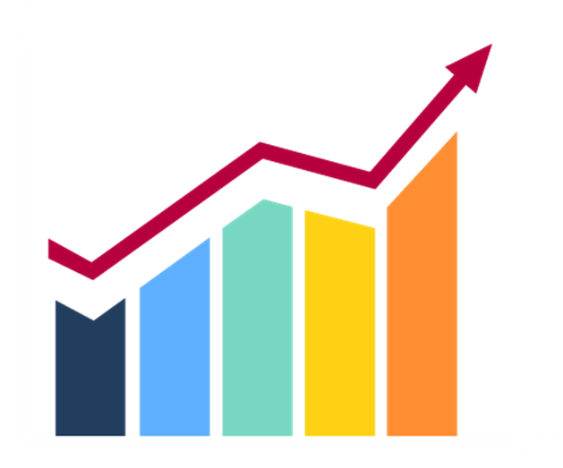
End Users & Features
The Primary Users
Primary users' persona are:
The Key features
Key features that address user needs is
Features solving the problems
Solve the problems of each end-user The trend analysis, Geographic distribution Average And Reports will have positive Impact on users.
Human resources.
Economists.
Investors and Organizations.
Government Leaders.
Data Analysts.
Layoffs trend Analysis
Geographical Layoffs Map distribution.
Average Layoffs Percentage.
Data sharing and generating reports.

Slide 7

End Users & Features
Average Layoffs Percentage
Uncovering and acknowledge of the Layoffs Average within companies and industries:
Geographical Layoffs Map distr
Map distribution illustrate Layoffs affected regions and require interventions
Layoffs Trend Analysis
The trend Analysis allows end users to identify economy changes and patterns
Data Sharing also generating reports can be done easily
Data sharing
Impact HR to create workforce strategy.
Impact Data Analysts And decision makers by its informative insights.
Impact investors, decision makers and leaders to invest more and expand or not.
Impact mostly government leaders and organizations to make support programs for layoffs.

Slide 8

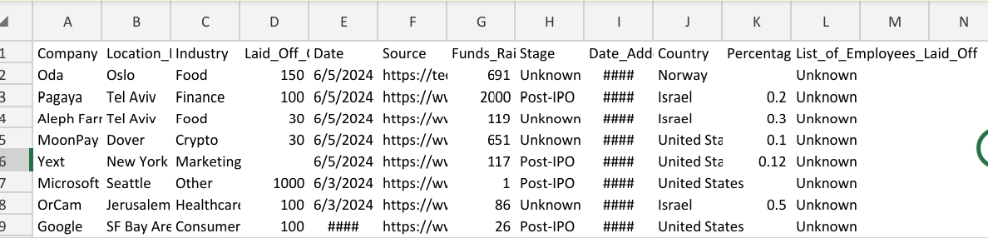
DATA Structure before
Columns Are:
1- Company. (where layoffs happened)
2- Location_HQ. (where layoff took place, allows analysis of economic study)
3- Industry. Describe company's operations)
4- Laid_off_count. (numbers of employees laid off)
5- Date.(time when layoffs occurred)
6- Source.(origin of data)
7- Funds_Raised.(amount of funds company raised)
8- Stage.(stage of layoffs)
9- Date_Added .(when it has been added)
10- Country. (where lay off took place, allows analysis of economic study)
11- Percentage. (percentage of total laid off employees)
12- List_of_employees_laid_off. (specific data)
Columns
12
Source
Online
Type
CSV file
https://www.kaggle.com/datasets/theakhilb/layoffs-data-2022?utm_medium=social&utm_campaign=kaggle-dataset-share&utm_source=linkedin.
CSV Dataset of Layoffs

Slide 9
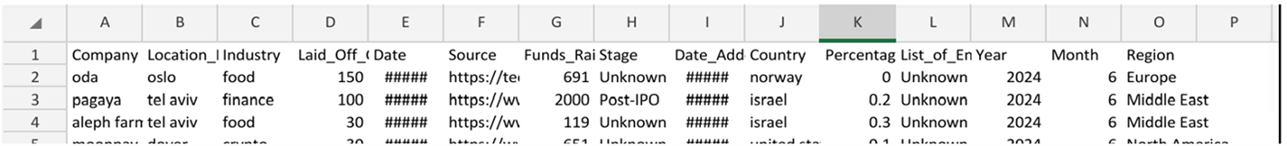
DATA Structure after
Columns Are:
1- Company type text.
2- Location_HQ type text.
3- Industry type text.
4- Laid_off_count type whole number.
5- Date type Date Date/time.
6- Source type text.
7- Funds_Raised type decimal number.
8- Stage type text.
9- Date_Added type Date/time.
10- Country type text.
11- Percentage type decimal number.
12- List_of_employees_laid_off type text.
13- Year type whole number.
14- Month type whole number.
15- Region type text.
Columns
15
Source
Modified
Type
CSV file
CSV Dataset of Layoffs

Slide 10
SQL
1. Data Inspection
2. Remove Duplicate Records Keep one occurrence for each duplicate entry based on company and date:
3. Handle Missing Values (Without Deleting Nulls) Use COALESCE to provide fallback values only in queries without altering the underlying data.

Slide 11
SQL
4. Correct Data Types Ensure data type correction without dropping columns:
Keep both old & new columns to avoid Data loss.
5. Standardize Text Fields Handle text normalization while keeping NULL values intact
6. Remove Outliers and Invalid Data Avoid unnecessary deletions by keeping questionable records intact.

Slide 12
SQL
7. Data Enrichment Populate new columns while keeping NULL values where appropriate.
8. Quality Assurance Check for missing data without replacing or deleting it.

Slide 13
SQL
Summary
Clean Data Ready for Visualization This workflow ensures:
1- Data Integrity:
No duplicates, outliers, or invalid data points.
2- Consistency:
Standardized text and accurate data types.
3- Enrichment:
Additional columns like year, month, and region for better analysis.
4- Scalability:
Structured, reusable SQL queries suitable for enterprise use.
N>B
Duplicates removed based on Company and Date.
Data types corrected (dates standardized, numeric values validated).
New analytical columns added (Year, Month, Region)

Slide 14
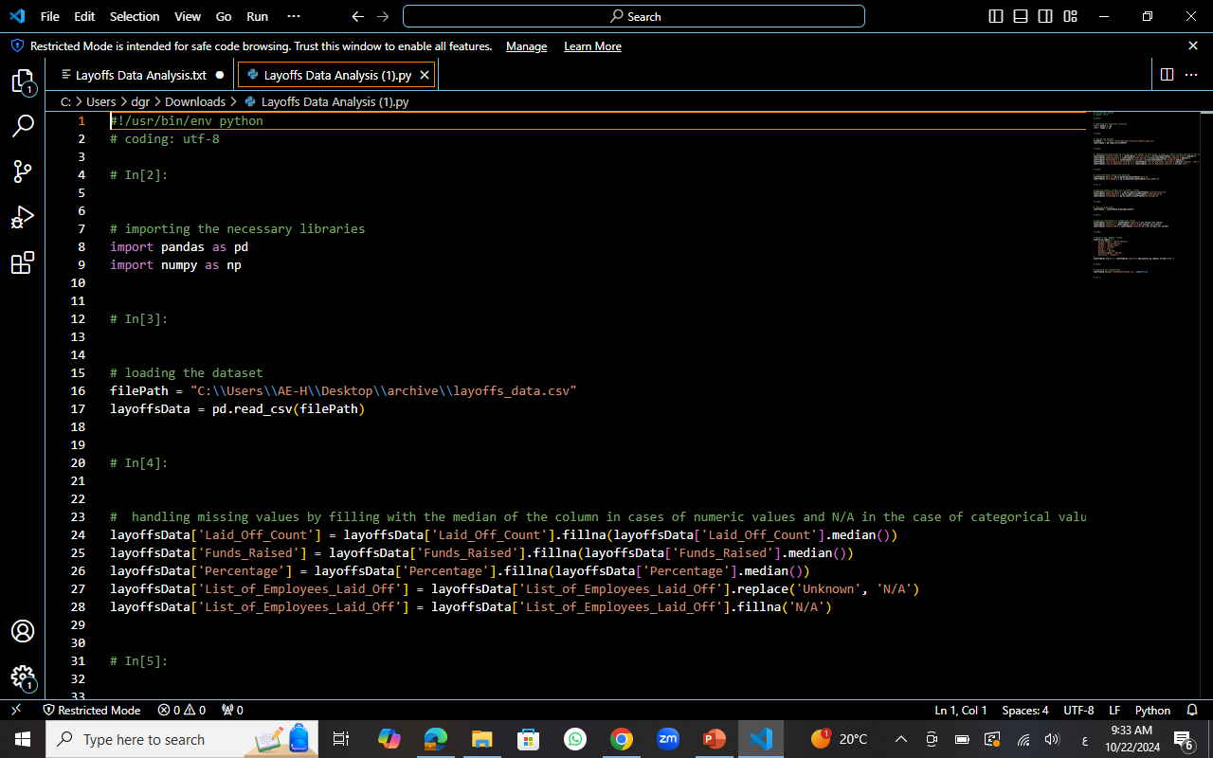
Python
1.Import
2.Load
3.Handling missing values

Slide 15

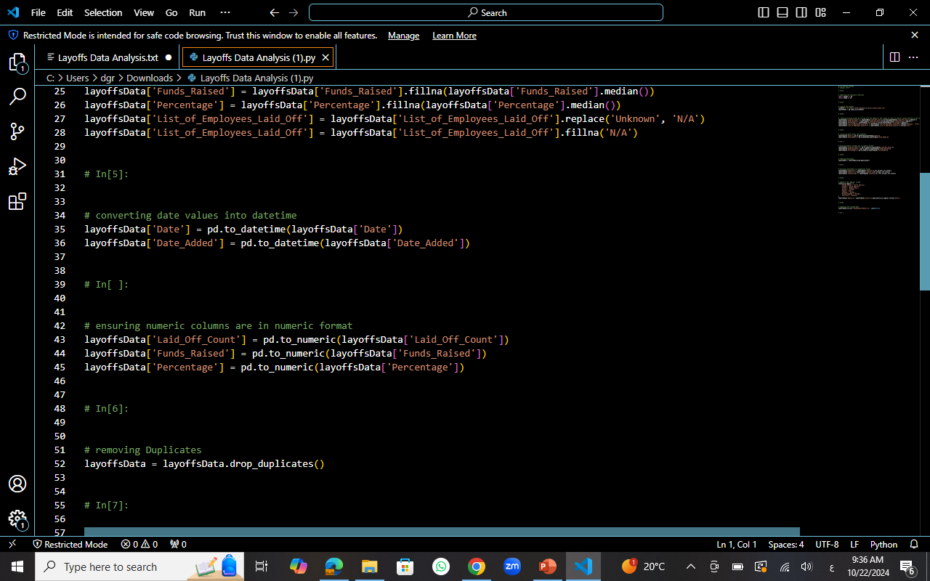
Python
4.Convert Date type
5.Ensure numeric format
6.Remove duplications

Slide 16
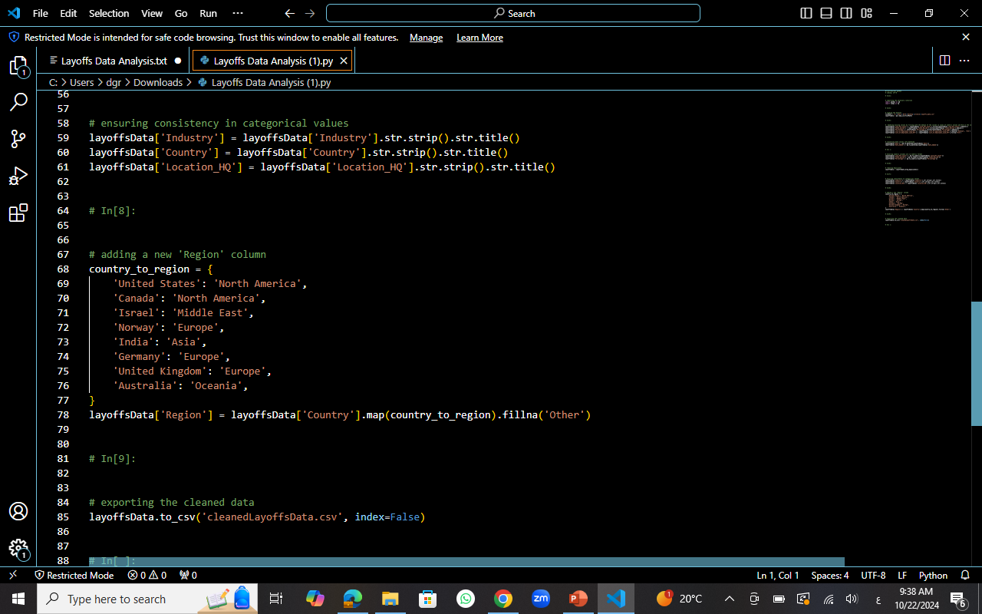
7.Ensure consistency of categorial values
8.Add new columns
9.Export CSV file
Python

Slide 17


Frameworks & Deliverables
Application used | Why
Zoom | Online meetings
SQL code | programming
Python code | programming
Plateau | Visualization
Power BI | Visualization
Power Point | Presentation
Deliverables:
1- CSV file of cleaned Data.
2- Dash-Board by Plateau.
3- Dash-Board by Power-BI.
4- Project Presentation.

Slide 18
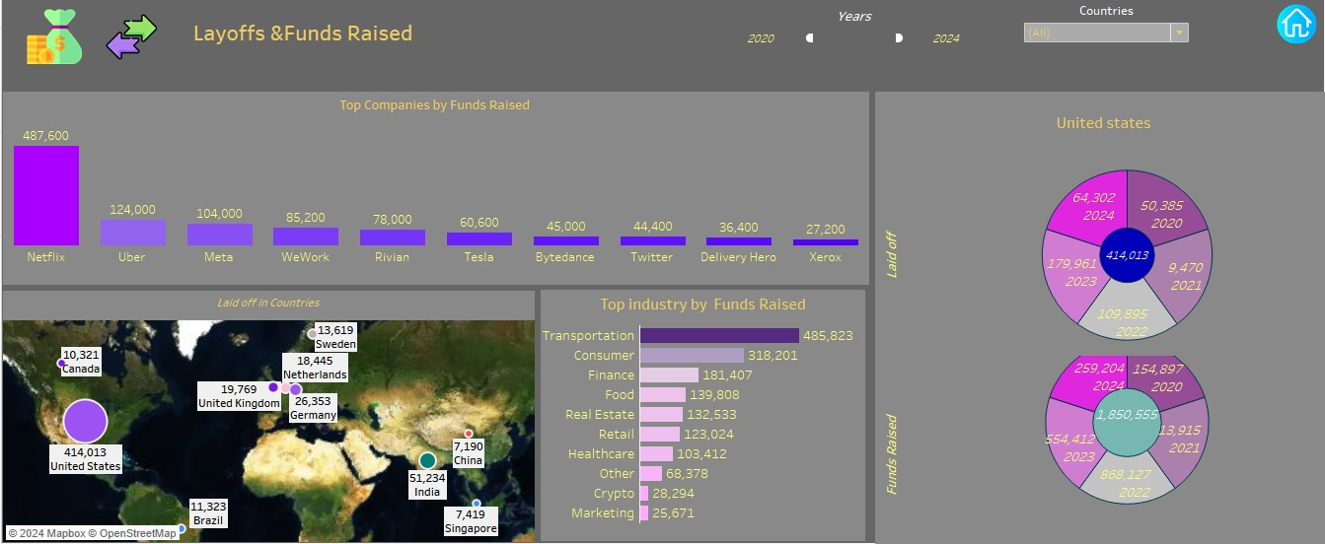
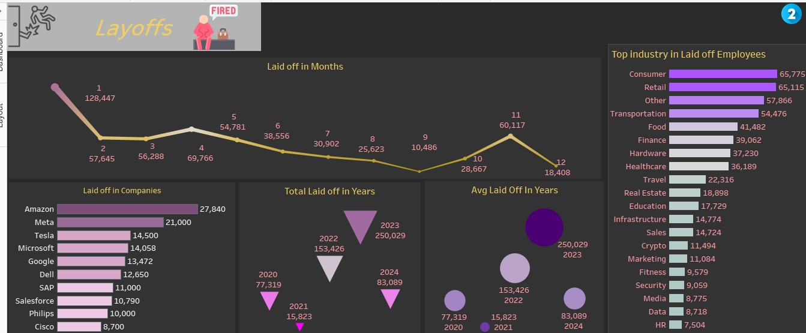
Plateau Dash-board

Slide 19
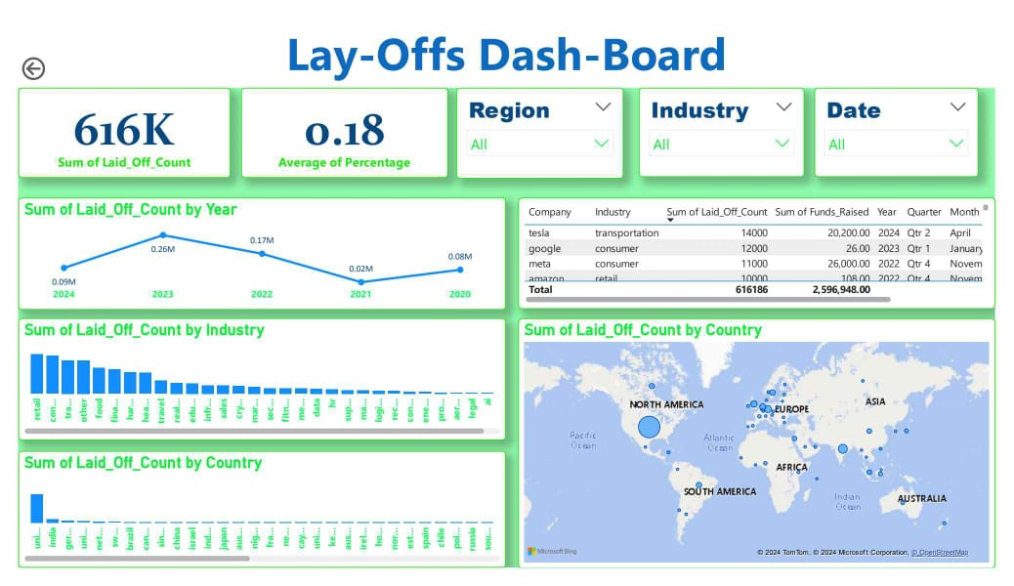
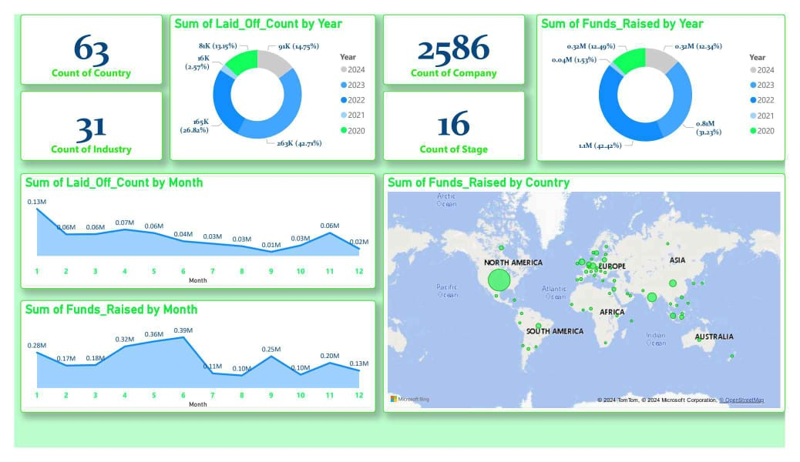
Power BI Dash-board

Slide 20
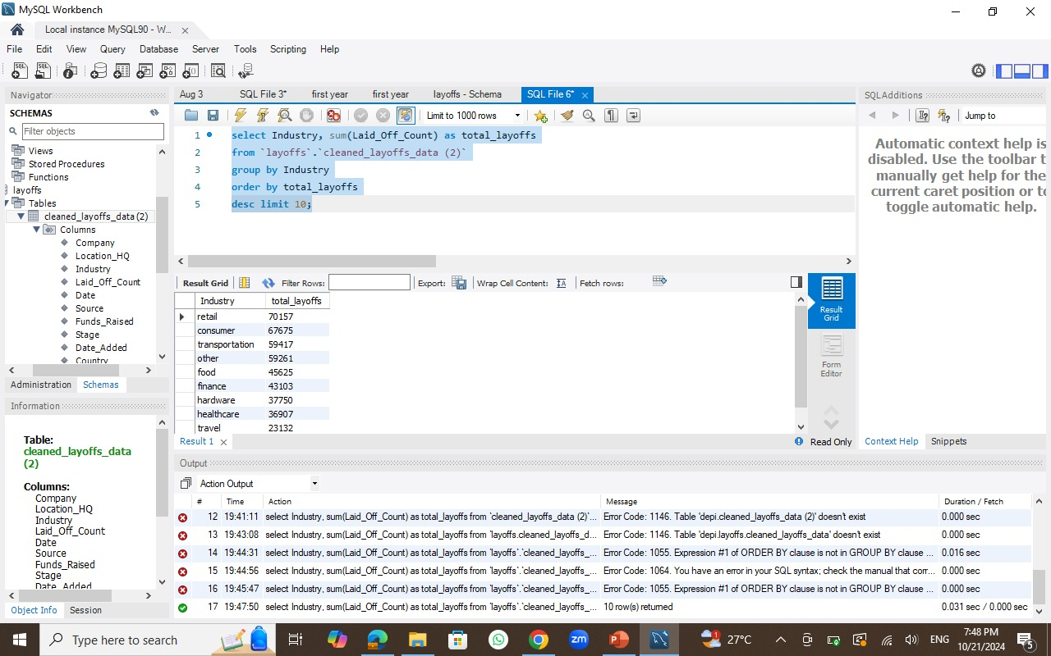
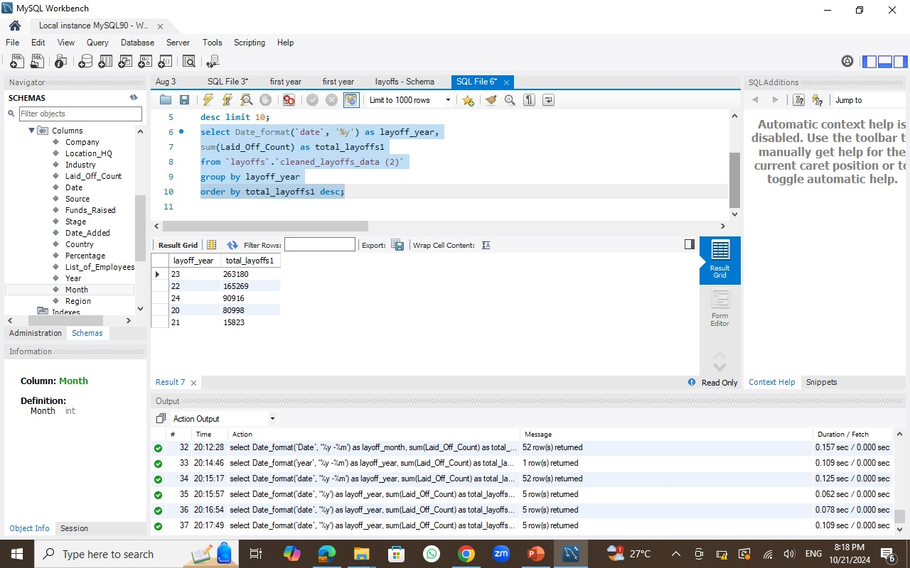
My SQL Exploratory Data Analysis
Q1- Which industry has the most layoffs?
The dataset shows the most affected industry sectors and
The answer is retail of total of 70157 layoffs
Q2- how layoffs changed through the years?
Trends query shows the most affected year and
The answer is 2023

Slide 21
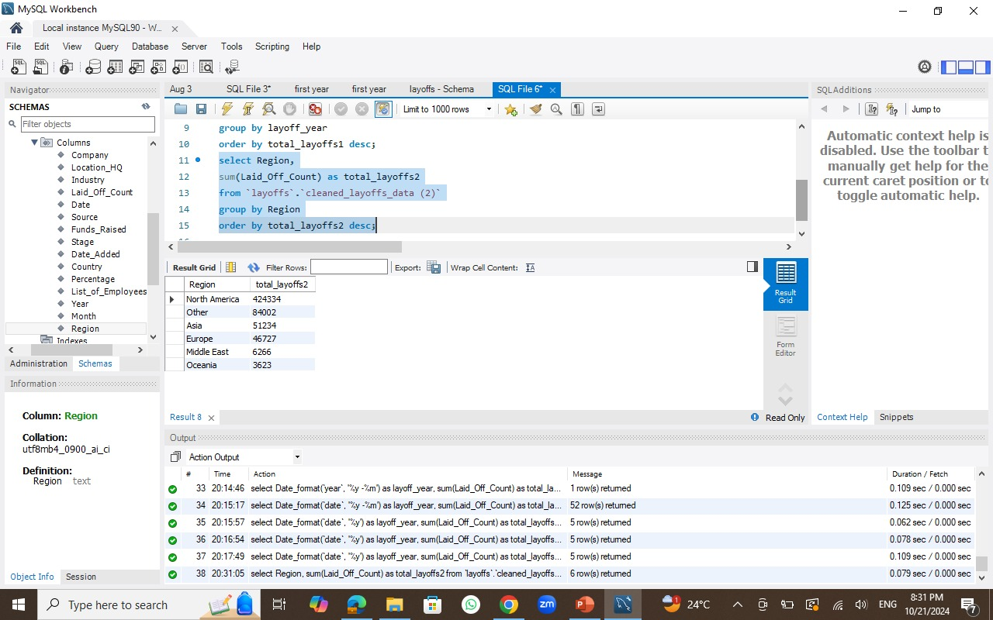
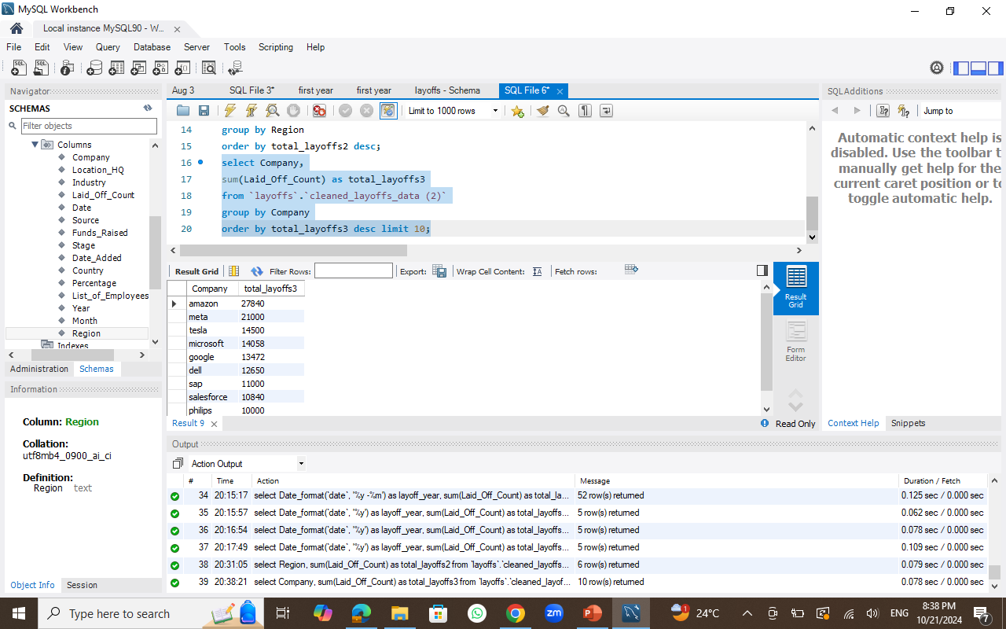
My SQL Exploratory Data Analysis
Q3- Which region has the most layoffs?
The dataset shows the most affected region and
The answer is North America
Q4- Which companies is the most affected?
The dataset shows the most affected companies and
The answer is Amazon with total '27840’ layoffs.

Slide 22
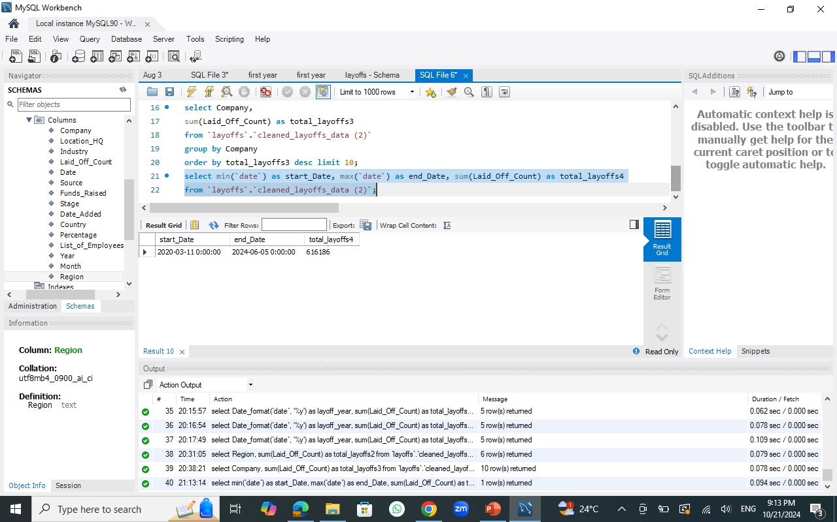
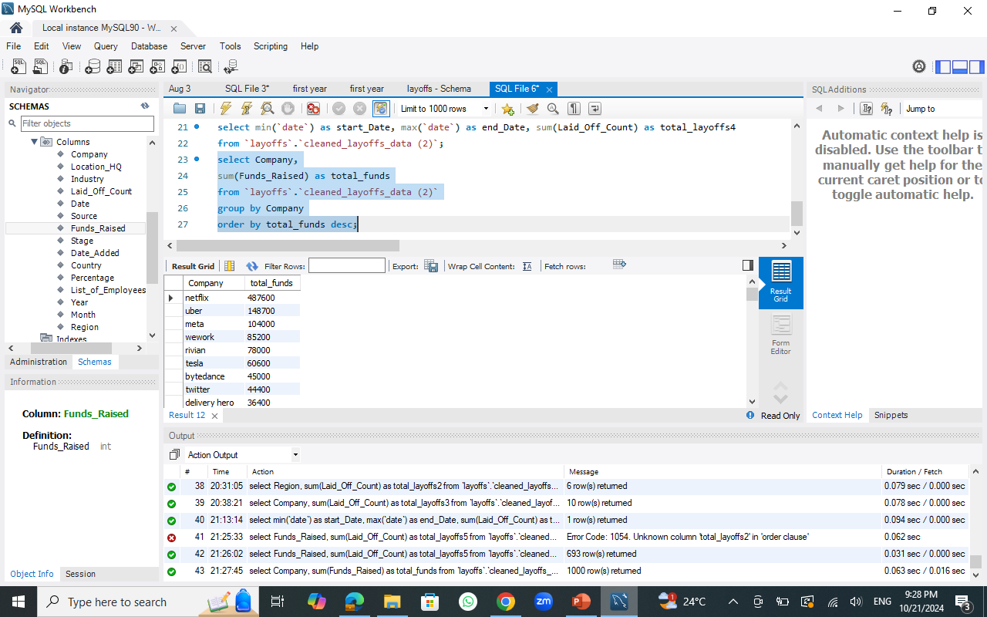
My SQL Exploratory Data Analysis
Q5- how many layoffs?
The dataset shows the total layoffs during a specific period and
The answer is 616186 between 11/3/2020 till 5/6/2024.
Q6- Which companies has the most fund raised?
The dataset shows the most companies has fund raised and
The answer is Netflix with total '487600’ of fund raised.

Slide 23



TIMELINE FOR DELIVERABLES
19-9-2024
7-10-2024
16-10-2024
17-10-2024
20-10-2024
PRESENT
Team Group
Project Idea
Cleaned Data
Plateau Dashboard
Power BI Dashboard
Final Project
Group Creation
Idea Brainstorming
Download dataset from Kaggle
Organize Data
Data Cleaning
Data enrichment
By Python & SQL
Visualization using plateau
Visualization using power BI
Project delivery
Key responsibilities | Team member
SQL code (data preparation: cleaning & enrichment) | Zainab Kamal
Python code (data preparation: cleaning & enrichment) | Anan Gamal
Plateau Dashboard | Merhan Hassan
Power BI Dashboard, SQL EDA, Presentation | Dalia Abbas

Slide 24

ThAnK YoU

